Slide 1
o
d
f
o
d
i
k
r
n

Slide 2
F O O D
D R I N K

Slide 3
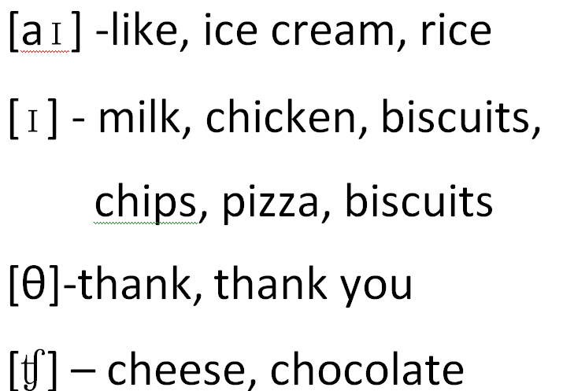

Slide 4
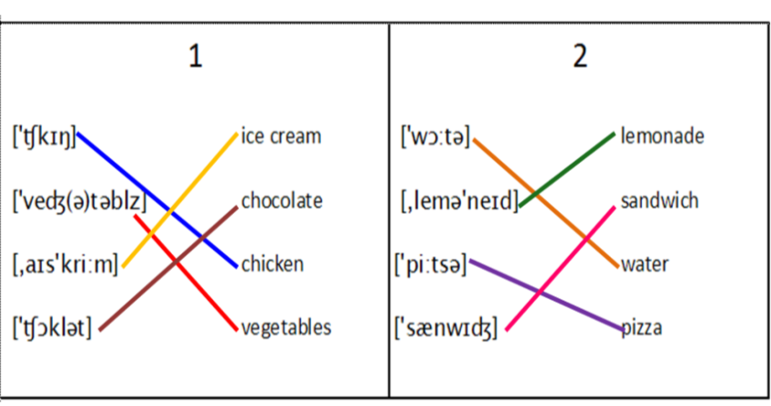

Slide 5
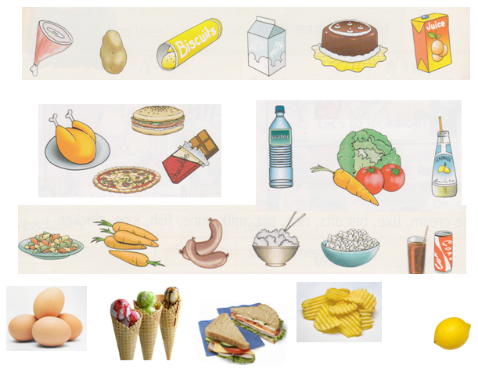
Countable or uncountable?

Slide 6

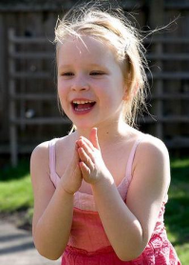
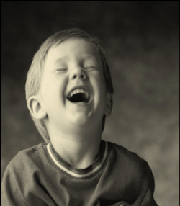
drink
vegetables
fruit

Slide 7

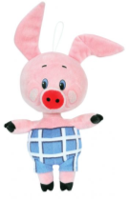
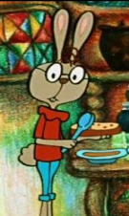
Winnie
Piglet
Rabbit

Slide 8

Shopping list for Winnie potatoes cakes biscuits cheese | Shopping list for Rabbit apples carrots cabbage water | Shopping list for Piglet eggs vegetables meat milk

Slide 9
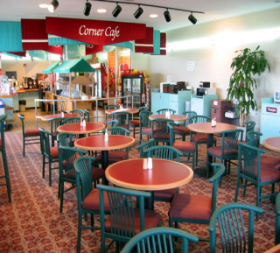
some/any
A: What do you want to eat?
B: Mm, I want chocolate and some cake?
A: Oh, they haven't got any chocolate.
B: Have they got any ice cream?
А : Yes! Do you want any juice?
B: No, thank you. Can I have some Coke, please?
A: Yes.
B: OK. Yummy!

Slide 10
An apple a day keeps a doctor away.

